Slide 1
Programming Fundamentals
Lecture 20-21

Slide 2
Objectives
Passing 1D arrays as an argument to a function
Passing a sized 1D array as formal parameter
Passing an un-sized 1D array as formal parameter
Passing 2D arrays as an argument to a function

Slide 3
Passing Arrays as Formal Parameter
Like other data types the arrays we can also pass the arrays as a formal parameter to a function in C++
There are three different ways to pass an array to a function
Method 1 - Passing a sized array
Method 2 - Passing an un-sized array
Method 3 - Passing array as a pointer
C++ does not allow passing an entire array as an argument to a function
So in each of above cases only the address to first element of the array is passed to function

Slide 4
Method 1 (Passing a Sized Array as Formal parameter)
In this method the formal parameter is passed as a sized array
The general syntax is
return_type_of_function function_identifier(array_type array_identifier[array_size]);
The following line is passing an integer type of array with size 10 to a function named output
void output(int arr[10]);

Slide 5
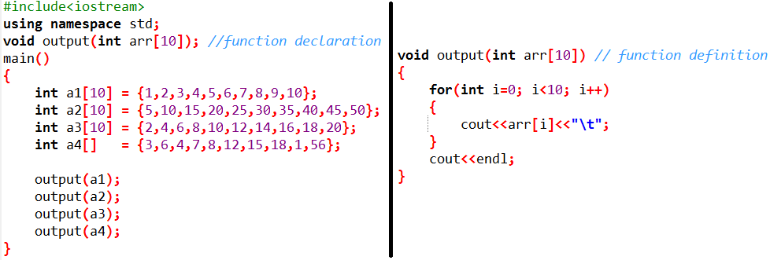
Method 1 (Passing a Sized Array as Formal parameter)
Example Program
Write a program to print all the elements of following arrays
int a1[5] = {1,2,3,4,5};
int a2[5] = {5,10,15,20,25};
int a3[5] = {2,4,6,8,10};
int a4[5] = {3,6,4,7,8};
There are two solutions to above scenario
Writing a separate code to display the elements of each array
Writing a function to display the array elements are calling it with each array
The approach with functions is more suitable and efficient

Slide 6
Method 2 (Passing an un-sized Array as Formal parameter)
Passing a sized array only works with arrays of same size
If we want to generalize our approach then we must pass an un-sized array
To pass an un-sized array we must pass an integer as well, to control the iterations
The general syntax is
return_type_of_function function_identifier(array_type array_identifier[], int);
For example the following line is passing an integer type of array with a variable size to a function named output
void output(int arr[],int size);

Slide 7
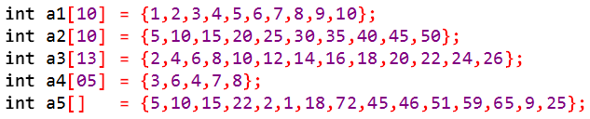
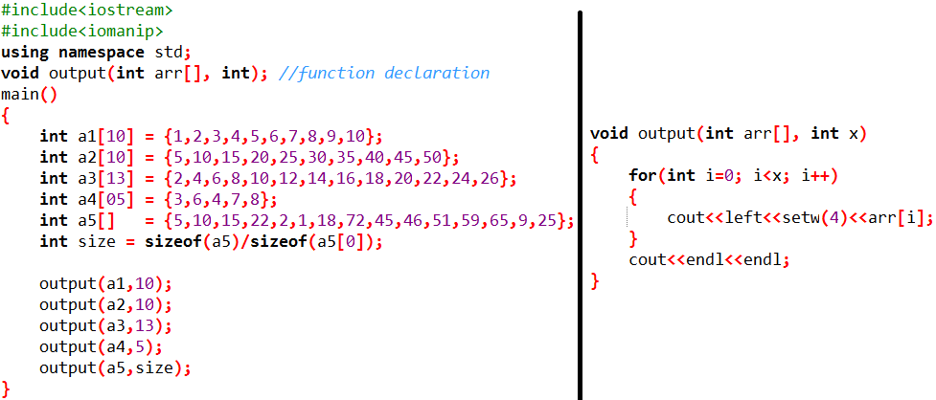
Method 2 (Passing an un-sized Array as Formal parameter)
Example Program
Write a program to print all the elements of following arrays
For a1, a2, a3 and a4 the size is given and we can directly pass it to the function along with an un-sized array
But for a5 the size is undefined. So it is always a better practice to calculate the size first and then pass it to the function
It can be done by using sizeof() function, as we did in previous classes
int size_a5 = sizeof(a5) / sizeof(a[0]);

Slide 8
Method 3 (Passing the array as a pointer to a function)
In this method the formal parameter is passed as a pointer
This method is similar to passing an un-sized array
The only difference is we only mention the identifier of array without square brackets
The general syntax is
return_type_of_function function_identifier(array_type *array_identifier, int);

Slide 9
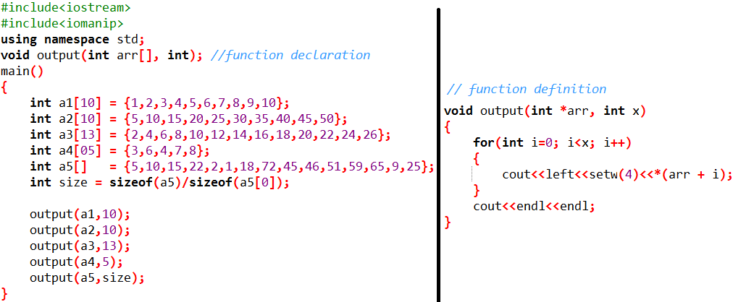
Method 3 (Passing the array as a pointer to a function)
Example Program
Write a program to print all the elements of following arrays

Slide 10
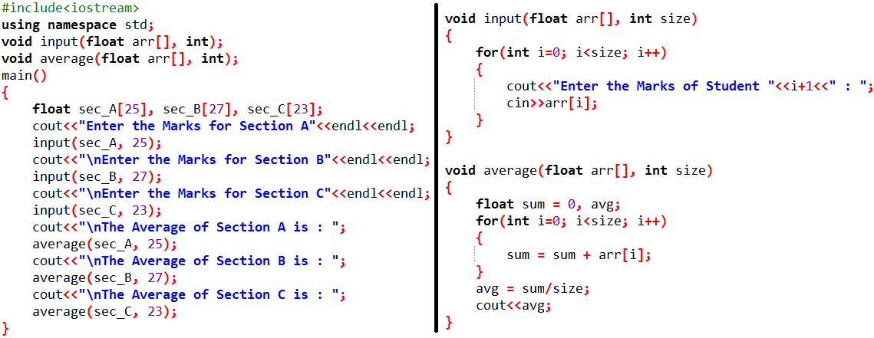
Practice Problem 1
There are three sections of Microprocessor Interfacing and Programming: A, B and C. And the No. of students in these sections are 25, 27 and 23 respectively. Write a C++ program which will ask the user to enter the marks obtained in mid-term I by each student of each section and then calculate the average of each section respectively.

Slide 11
Passing 2D Arrays as Formal Parameter
2D arrays are passed in the same way as we passed 1D arrays
Method 1
Method 2
Method 3

Slide 12

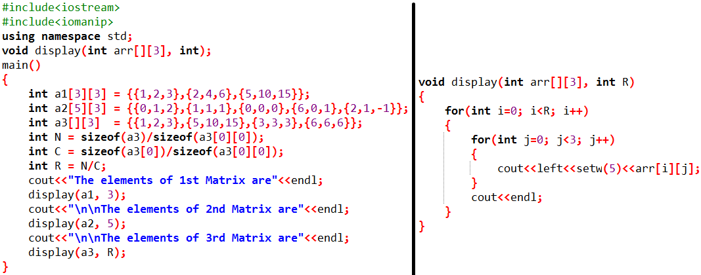
Practice Problem 2
Write an efficient C++ program to print the following 2D arrays in the form of matrices

Slide 13
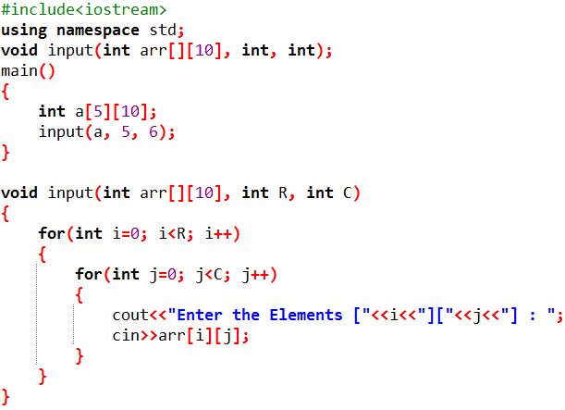
Practice Problem 3
Write a function that can take the input in the form of a matrix (matrix elements are real numbers) with a maximum of 10 columns and unknown rows.

Slide 14
Practice Problem 4
Code a matrices calculator with minimum possible lines of code.
The program should ask the user to enter the sizes of 2 matrices, their elements and then ask the user to enter an operation from + or – and finally display both the matrices and their addition or subtraction
Do it yourself

